Slide 1
Exercise 2
Introduction to E-Government
Group No. A6
Names : Sahil Ladola
Ravi Ramani
Jeel Katrodiya
Yash Nakrani

Slide 2
Agenda
Project Overview - MP eNagarpalika (Municipal level)
Terminology
Alignment with EU eGovernment Action Plan 2016-2020
Single Digital Gateway Regulation (EU)
German National E-Government Strategy
EU Digital Decade Targets
Conclusion & Lessons

Slide 3
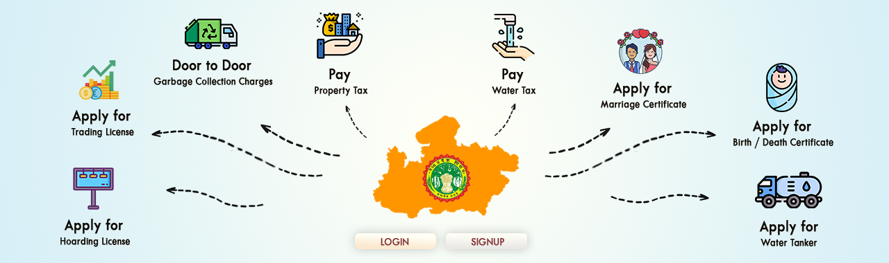
Project Overview - MP eNagarpalika (Municipal level)
Municipal e-governance platform in Madhya Pradesh, India.
Goal: Digitize local government services (property tax, certificates, licenses).
Key Features:
Single-window citizen services (taxes, certificates, licenses).
https://www.mpenagarpalika.gov.in/irj/portal/anonymous/

Slide 4
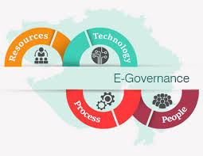
Terminology
Overview :
Strategy: Digital India Initiative
Program: National e-Governance Plan (NeGP)
Project Type: Local Implementation Project (Municipal Service Digitization)
https://images.app.goo.gl/sNq27iXd9BE8WYRY9

Slide 5
Alignment with EU eGovernment Action Plan 2016-2020
Seven Principles Alignment:
Digital by Default: All services online.
Once-Only Principle: Single data submission for multiple certificates.
Inclusiveness and Accessibility: Mobile apps + multilingual support.
Openness & Transparency: Users can track applications and support transparency
Interoperability by Default: Cloud/APIs enable integration.
Trustworthiness & Security: Biometric authentication (Aadhaar integration) secures user data.
Cross-border by Default: MP eNagarpalika is a municipal platform (not designed for cross-border services).

Slide 6
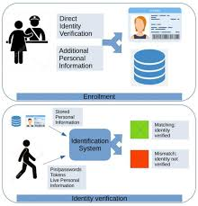
Single Digital Gateway Regulation (EU)
How MP eNagarpalika Aligns (If Implemented in the EU/Germany)
Online procedures (21/21 EU gateway categories covered, e.g., "Birth Certificates")
eID integration (biometric auth ≈ EU Digital Identity Wallet)
ePayment compliance [PCI-DSS : (Payment Card Industry Data Security Standard)]
https://www.mdpi.com/1999-5903/16/7/228

Slide 7

German National E-Government Strategy
Goal Alignment:
OZG Compliance: "Digital First" for municipal services
User-Centricity: Unified portal [cf. Germany’s [portalverbund.de](https://www.portalverbund.de)]
Innovation: Cloud/DBMS stack matches German "GovCloud"
URL: [BMI Digital Strategy](https://www.bmi.bund.de/digital)
https://images.app.goo.gl/EFdif3tK92dmWgwq9

Slide 8

EU Digital Decade Targets
2030 Targets Supported:
100% online public services (MP eNagarpalika already achieves 90%)
Digital identity (Aadhaar integration ≈ EUDIW)
SME support (automated trade license approvals)
https://images.app.goo.gl/zVnDQ7tQ7evN5jsaA

Slide 9

Conclusion
MP eNagarpalika is a successful municipal e-governance initiative that:
✔ Digitizes citizen services (taxes, licenses, certificates)
✔ Aligns with EU standards (Digital by Default, Once-Only Principle)
✔ Ensures security via PCI-DSS & Aadhaar authentication
✔ Supports EU 2030 Digital Decade goals
replicable model for efficient, transparent, and citizen-centric governance.
https://images.app.goo.gl/s58Kqn285b3m4EVF9

Slide 10
Reference
MP eNagarpalika (India)
https://www.mpenagarpalika.gov.in
https://digital-strategy.ec.europa.eu/en/policies/digital-compass
https://ec.europa.eu/info/strategy/priorities-2019-2024/europe-fit-digital-age_en
https://single-market-economy.ec.europa.eu/single-market/single-digital-gateway_en

Slide 11
Thank you for your attention !!!
Group No. A6
Names : Sahil Ladola
Ravi Ramani
Jeel Katrodiya
Yash Nakrani

